Slide 1
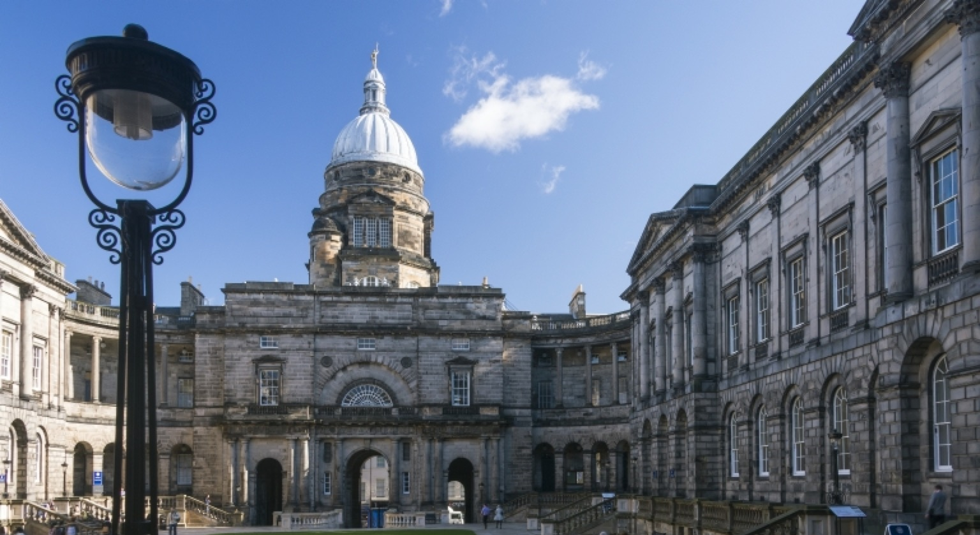
Human Genome Editing: The way forward?
2nd International Human Genome Editing Summit Sarah Chan
Chancellor’s Fellow & Reader, Usher Institute
Centre for Biomedicine, Self & Society
Director, Mason Institute
University of Edinburgh

Slide 2

What are principles for?
Can we have common principles but different regulatory outcomes?
Less about substantive principles, more about process?
How do we make meaningful use of principles?
How to go from principles to actions / decisions?
Do we need (& can we define) a universal set of principles?

Slide 3
Engagement into governance?
How should publics participate in policy discourses? What constitutes meaningful engagement?
From local to global engagement:
Different social, cultural, political contexts; expectations
What assumptions are we embedding?
“active engagement with a wide range of stakeholders…” (UK funders’ statement, 2015)
“meaningful and substantial public engagement… [Decisions] should be made through inclusive, deliberative processes…” (Hinxton, 2015)
“a comparison of the different visions of desirable future states of affairs and narratives… feeding back into a public discourse informing governance” (Nuffield, 2016)
“… transparent and inclusive public policy debates… [and] broad participation and input by the public… are particularly critical conditions…” (NASEM, 2017)
“broad, inclusive societal debate” (Nuffield, 2018)

Slide 4
Ethics into policy
How are ethically salient concepts negotiated?
Risk
Moral vs physical risk?
Who / what is harmed & how?
e.g. heritable human genome editing; gene drives & species integrity
How should risks be distributed?
Somatic vs germline
Individual vs population
Choice
“… no alternatives”
What constitutes an “alternative”?
Context-dependent
Reproduction; health; ‘good life’
Agency & responsibility
E.g. informed consent

Slide 5
Principles into action
What do we do when …NOW…?
The next steps are crucial
How should scientific communities respond?
Multiple ‘publics’; multiple ‘scientific communities’
Global politics
Local contexts and values
Differences of scientific and ethical opinion (e.g. acceptable risk)
Disruption to traditional modes of knowledge production and innovation
What counts as ‘(good) science’?
Who is allowed to be a knowledge producer?
Modes of action with respect to science: participants, patients, … consumers?

Slide 6

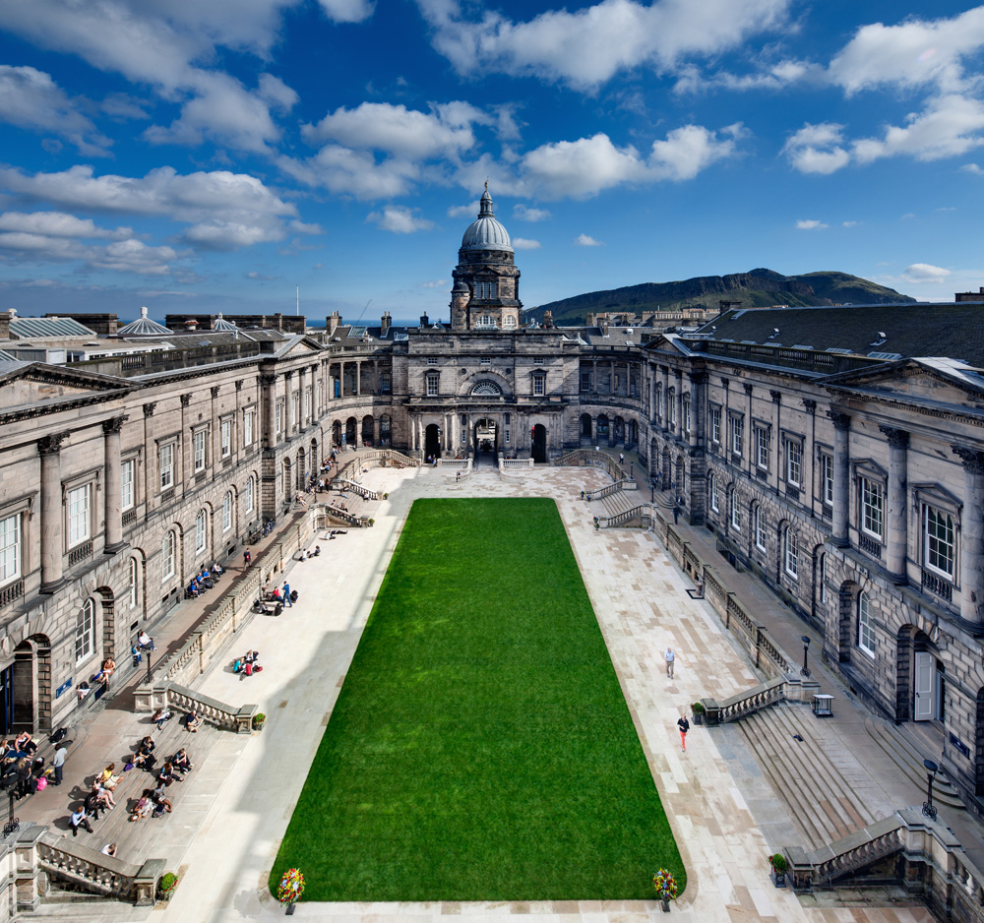



Thank you!
sarah.chan@ed.ac.uk
@sarahwchan

